Slide 1
IS 436 Deliverable 1
By: Jessica Park, Farah Siddiqui, Betelhem Taddele, Danny Nguyen,
Jatin Chauhan, Munam Ghazanfar, Ninh Ngo

Slide 2

Project Sponsor
Sponsor: Syed Iqbal
Business: Popeyes Louisiana Kitchen

Slide 3
Business Needs
Redbook features (HACCP log, Daily Food Excellence Audit, Rush-Readiness Checklist)
Ability to log photos of products and sanitation
Ability to upload numbers (profit, labor, inventory)
Manage multiple restaurants collectively and efficiently all in one app

Slide 4
Business Requirements
User must be able to add the financial information sales, labor percentage periodic in the app.
User must be able to upload the photo of the products.
User/Admin must be able to create multiple users and profile
User should be able to access a To-do checklist i.e Rush-Readiness checklist,HACCP log and Sanitation practices.
User should be able to notify the Managers to complete a task which was done incorrectly or was not finished.
Automated report of all the text and critical instance that occur in each restaurant.
If the check box for HACCP log that was not checked by 11am, 3pm, 7pm,11pm, it should trigger an email response.
App should include the speed time of the drive thru and the number of cars per interval.
Admin should be able to view a summary report of other users to ensure that the assigned task has been completed.

Slide 5

Business Value
Increased Productivity
Increased Quality Control
Managers can now input/provide data through one unified portal.
Increased Workflow Proficiency
Customers benefit through better and more focused tasks.
The biggest benefit by the application comes down to increased workflow. By creating a one stop shop to monitor important tasks means managers can divide time between tasks easier. Stakeholder does not need to be over the shoulder of his employees.
Simplified Requirements
Reduced Clutter
Each task and requirement is displayed so less training for new managers.
Less text/email updates requires less attention that can be focused elsewhere.

Slide 6
Special Issues or Constraints
Data must be protected from any html or sql injections.
Only managers or owner could use this app.
Queries must display information according to the account type (Admin/Manager).
Overall summary with up-to-date information must be displayed to Admin in one specific space.
Project should be finished within a year

Slide 7
Feasibility Analysis
Technical feasibility → risk assessment and solutions
Economic feasibility → cost-benefit analysis
Organizational feasibility → strategic alignment

Slide 8
Technical Feasibility
Currently use email as primary means of communication and to record profits, inventory, labor, etc.
Training required to use new system
Application is to be used by only managers
Other employees (crew members) do not have to learn new system
Manager is already familiar with Redbook features
New technology would include uploading photos and numbers
Navigating web application

Slide 9
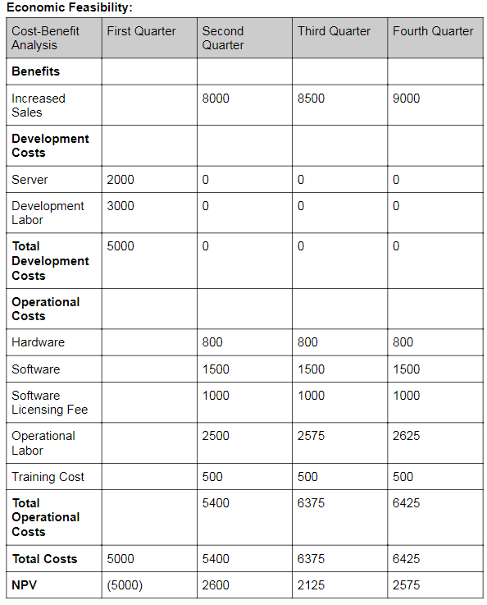
Cost-Benefit Analysis

Slide 10
Organizational Feasibility
Project goal is to develop an application to provide a more efficient method to monitor and record business numbers and safety/health requirements
Implementation of the new system will allow
tracking and recording data through automation rather than by hand
consistent method of recording data
easy access to desired business information
streamline manager responsibilities (salaries, tax payments)
managers to focus on other areas in their work

Slide 11

Team Meeting Times
Tuesday | Wednesday | Thursday
16:00 - 18:00 | 11:30 - 14:30 | 15:30 - 16:30

